Slide 1
School of Computing Science and Engineering
Course Code : CSCS3050 Course Name: Intrusion Detection and Prevention System
Computer workshop
( BCS01T10004)
Name of the Faculty: Indervati Program Name: B.Tech

Slide 2
School of Computing Science and Engineering
Course Code : CSCS3050 Course Name: Intrusion Detection and Prevention System
SMPS(switch mode power supply)
The full name of SMPS is Switch-Mode Power Supply. SMPS is defined in simple language when the need for electricity comes in the form of a switch. In which electrical energy is converted from one form to another with essential properties called SMPS. This power is used to obtain a regulatory DC input voltage from DC output or uncontrollable AC for power. SMPS is just as complex as any other power supply system. This is a power source used for loading.
Program Name: B.Tech

Slide 3
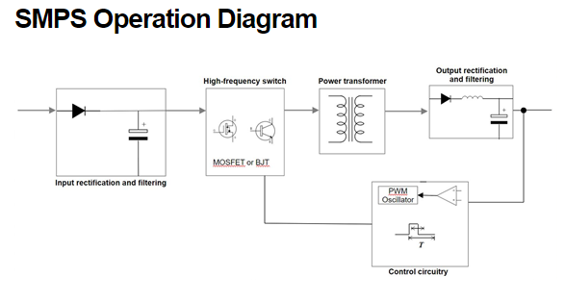
School of Computing Science and Engineering
Course Code : CSCS3050 Course Name: Intrusion Detection and Prevention System
WORKING OF SMPS
Program Name: B.Tech

Slide 4
School of Computing Science and Engineering
Course Code : CSCS3050 Course Name: Intrusion Detection and Prevention System
In previous slides outlines how the SMPS operates. An SMPS’s functionality is more complex than that of a linear regulator, but we can break it down into five stages:
In the first stage, the incoming AC power runs through a rectifier and undergoes filtration to produce DC
The SMPS works at high frequencies, so a high-frequency switch processes the DC signal, which creates a high-frequency pulsating DC signal
The power transformer steps down the high-voltage DC signal to a DC signal of the appropriate level
The stepped-down DC signal is rectified and filtered to a achieve a steady, constant DV output
The control circuitry monitors the output voltage and adjusts the high-frequency switch on-the-fly to ensure a continuous output stream of the desired voltage
Program Name: B.Tech

Slide 5
School of Computing Science and Engineering
Course Code : CSCS3050 Course Name: Intrusion Detection and Prevention System
What is Port ?
A computer port or a communication port is a connection point used as an interface between the computer & the peripherals like keyboard, mouse, printer, display unit, monitor, flash drive and speaker. The computer port transmits the data from any peripheral to the computer. In general, the communication ports are available in two types and the classification of this can be done based on the protocol used & type for communication like Serial Ports as well as Parallel Ports.
Program Name: B.Tech

Slide 6
) Declaring Structure variables separately
struct Student
School of Computing Science and Engineering
Course Code : CSCS3050 Course Name: Intrusion Detection and Prevention System
Types of Computer Ports
There are different types of ports available in a computer network. Some of them are discussed below.
PS/02
Serial Port
Parallel Port
Ethernet
VGA Port
USB Port
DVI Port
HDMI Port
Display Port
Program Name: B.Tech

Slide 7
School of Computing Science and Engineering
Course Code : CSCS3050 Course Name: Intrusion Detection and Prevention System
PS/02 Computer Port
It is a DIN(deutches institutf normung) connector available with 6-pins. This type of port is used to connect keyboard & mouse. It is developed and introduced by the personal systems of IBM. These ports are available in color-coded. For the keyboard, it is purple whereas, for the mouse, it is green.
The pin configuration of both the keyboard & mouse is the same so, computers do not identify once they connected to the wrong ports.
Serial Port
A serial port is used to connect peripherals with the help of a serial protocol to transmit the 1-bit data at a time over an only communication line. The best example of this port is D-Subminiature otherwise a D-sub connector and the main function of these ports are to carry RS232 signals.
Program Name: B.Tech

Slide 8
School of Computing Science and Engineering
Course Code : CSCS3050 Course Name: Intrusion Detection and Prevention System
Parallel Port
A parallel port is also used as an interface between a computer & its peripheral device with the help of a wire or above one communication line. The best example of this port is a printer port.
Ethernet Port
This type of port is used to unite the network cable to a PC. Once the cable is plugged into Ethernet port, then it can lead either to a cable modem, network hub, an Internet gateway or DSL modem. Most of the computers built with an Ethernet port. If the port is damaged, then it can be changed by integrating the adapter card.
VGA Port
VGA stands for Video Graphics Array. It is a 3 row with a 15-pin DE-15 connector. It is used in many monitors, laptops, video cards, projectors, etc. Sometimes, this port was used on laptops otherwise other portable devices in place of the full-size VGA connector.
Program Name: B.Tech

Slide 9
School of Computing Science and Engineering
Course Code : BCSE2073 Course Name: Database management System
The current LCD as well as LED monitors support VGA ports however the quality of the picture can be reduced. This port carries analog video signals up to 648X480.resolution. Some laptops are inbuilt with VGA ports to unite exterior monitors otherwise projectors.
USB Port
There are different types of ports are used in a computer network, in that a USB port is the most commonly used one. The universal serial bus port is very successful. The main function of this port is to connect all the peripherals to PCs like printers, keyboards, external hard drives, mice, scanners, cameras, and many more. This port is available on all kinds of computers like laptops, desktops, notebooks, tablets, etc.
Program Name: B.Tech

Slide 10
School of Computing Science and Engineering
Course Code : BCSE2073 Course Name: Database management System
DVI Port
This port is a digital interface among the display controller of computers as well as video o/p device such as a monitor otherwise projector. This was developed to allow the lossless transmission of digital video signals as well as to change the analog VGA technology.
These ports are classified into three types namely DVI-I, DVI-D & DVI-A. Here, DVI-I port integrates analog & digital signals, DVI-A port supports simply analog signals & DVI-D supports simply digital signals.
HDMI Computer Port
HDMI stands for “High Definition Multimedia Interface”. It works like a digital interface to connect High Definition as well as Ultra High Definition devices like HDTVs, computer monitors, gaming consoles, HD Cameras, Blu-Ray players, etc. This port carries audio signals like compressed/uncompressed & uncompressed video.
This port includes 19-pins and HDMI 2.0 is the latest version, used to carry digital video signal up to 4096×2160 resolution &32 audio channels.
Program Name: B.Tech

Slide 11
School of Computing Science and Engineering
Course Code : BCSE2073 Course Name: Database management System
Display Computer Port
This type of port is one kind of digital display interface including multiple audio channels & other types of data. This port was developed by an association of computers as well as chipmakers. These ports are Sony, Maxell, Philip & Lattice and then it was standardized through the VESA (Video Electronics Standards Association). The main intention of this Port is to replace DVI & VGA ports. It carries audio, video, USB and other types of data. It is scalable with other types of interfaces like DVI & HDMI by using active otherwise passive adapters. The most recent version of this port is Display Port 1.3 that can handle up to 7680 X 4320 resolutions.
Program Name: B.Tech

Slide 12
School of Computing Science and Engineering
Course Code : BCSE2073 Course Name: Database management System
Assembling & Disassembling the System Hardware Components of the Personal Computer
PC assembly step by step
Place the processor in the socket.
Insert the system memory.
Install the CPU heatsink.
Connect the dedicated graphics card.
Connect the SSD.
Plug the power cables from the PSU into the motherboard, graphics card, SSD and cooler.
Install the components in the PC case.
Program Name: B.Tech

Slide 13
School of Computing Science and Engineering
Course Code : BCSE2073 Course Name: Database management System
7. Handle all parts with care. Place each piece you remove carefully down onto a stable surface.
8. If a component does not come out easily, do not forcefully remove it. Instead, check that you are removing it correctly and that no wires or other parts are in the way.
9. Be careful when holding the motherboard, it’s underside actually quite pointy and able to hurt you.
10. Never attempt to remove the power source, a box attached to the side or bottom of the unit to which all cables are connected.
11. When removing any cables, wires or ribbons, make sure to grasp the wire at the base or head to keep it from breaking.
12. Be careful not to drop any small parts (particularly screws) into unreachable areas such as into the computer fan or disk drive.
13. Take note that the three of the most damaging things to a computer are moisture (sweat, drinking water), shock (electric or from being dropped) and dust (any debris from household dust to bits of food).
Have a safe experience in assembling your computer!
Program Name: B.Tech

Slide 14
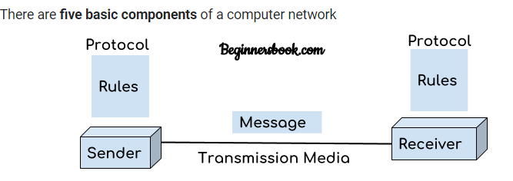
School of Computing Science and Engineering
Course Code : BCSE2073 Course Name: Database management System
Introduction to Computer Network
A computer network is a group of devices connected with each other through a transmission medium such as wires, cables etc. These devices can be computers, printers, scanners, Fax machines etc.
The purpose of having computer network is to send and receive data stored in other devices over the network. These devices are often referred as nodes.
There are five basic components of a computer network
Program Name: B.Tech

Slide 15
School of Computing Science and Engineering
Course Code : BCSE2073 Course Name: Database management System
There are five basic components of a computer network
Sender
Message
Protocol
Reciever
Transmission media
Program Name: B.Tech

Slide 16
School of Computing Science and Engineering
Course Code : CSCS3050 Course Name: Intrusion Detection and Prevention System
Reference:
https://citadel-information.com/wp-content/uploads/2012/08/nist-sp800-94-guide-to-intrusion-detection-and-prevention-systems-2007.pdf
https://en.wikipedia.org/wiki/Intrusion_detection_system
Program Name: B.Tech

Slide 17


